Slide 1

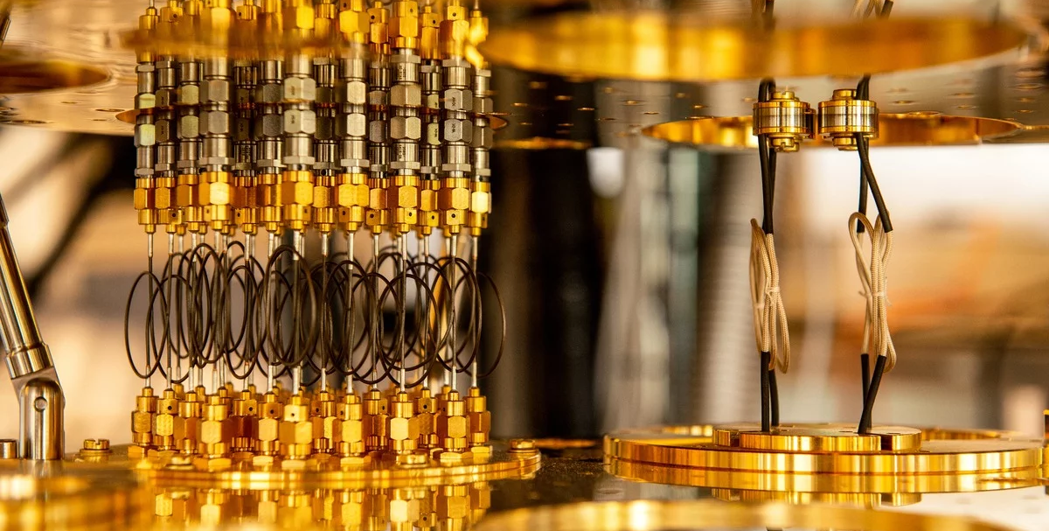
Quantum Computing Workshop Foundations of Quantum Computing
CREO Research Center
Presenter: Chibuike Okekeogbu

Slide 2
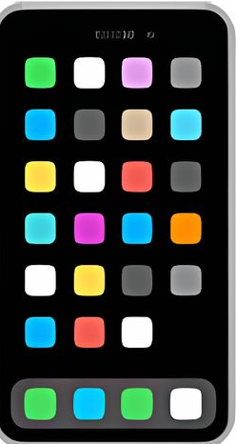
Today’s Mission:
Explore the basics of quantum computing, build your first quantum circuit and understand why quantum computing will revolutionize cybersecurity
Have ready: Laptop with Python installed
Notes:
Welcome everyone to the first workshop in our Quantum Computing series! I'm excited to guide you through this journey into the quantum realm.
Today's mission is simple but powerful: by the end of this hour, you'll have written and run your first quantum program, and you'll understand why quantum computing is about to revolutionize cybersecurity.
Before we dive in, please make sure you have Python installed on your laptop. If you're still setting up, no worries - you can follow along and catch up during our hands-on sections. Let's begin!

Slide 3
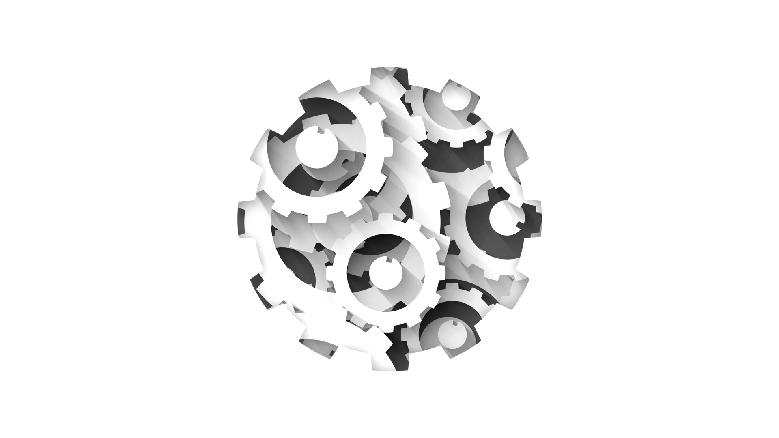
Classical Mechanics vs
Quantum Mechanics

Slide 4
Properties of Quantum Mechanics
Superposition: describes the behavior of particles or systems when they exist in multiple states
Entanglement: This is a quantum phenomenon where the properties of two or more particles become correlated in such a way that the state of one particle is dependent on the state of another.
Interference: This refers to the interaction or overlapping of waves, signals or other phenomena that results in a combined effect that is different from the individual effects of each component.

Slide 5
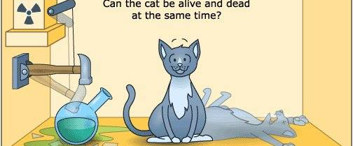
Schrödinger’s Cat

Slide 6
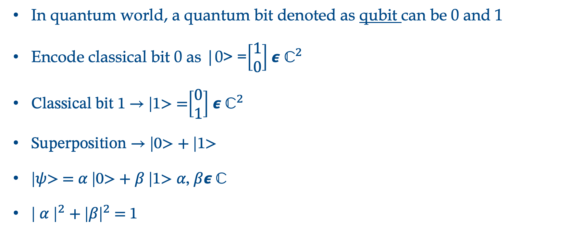
Quantum System
In quantum world, a quantum bit denoted as qubit can be 0 and 1
Encode classical bit 0 as |0> =$\left[\begin{matrix}1 \\ 0\end{matrix}\right]$ 𝟄 ${\text{ℂ}}^{2}$
Classical bit 1 → |1> =$\left[\begin{matrix}0 \\ 1\end{matrix}\right]$ 𝟄 ${\text{ℂ}}^{2}$
Superposition → |0> + |1>
|𝜓> = 𝛼 |0> + 𝛽 |1> 𝛼, 𝛽𝟄$\text{ℂ}$
${\text{| }\text{α}\text{ |}}^{2}$ + ${\text{|}\text{β}\text{|}}^{2}$ = 1

Slide 7
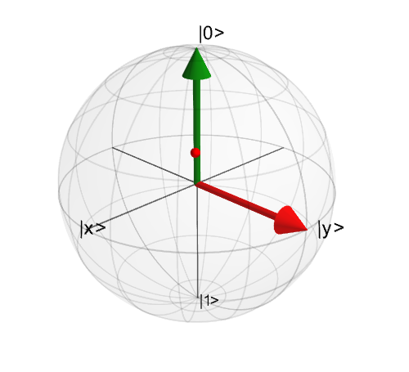
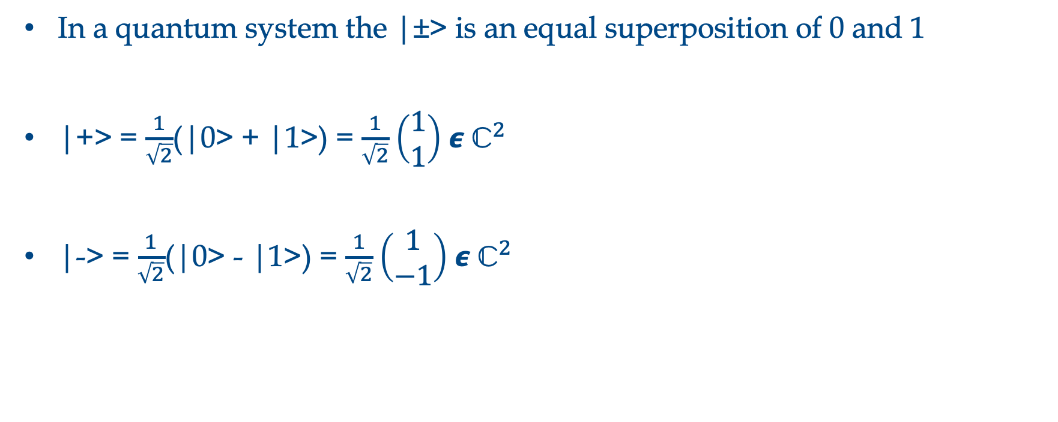
Quantum System
In a quantum system the |±> is an equal superposition of 0 and 1
|+> = $\frac{1}{\sqrt{2}}$(|0> + |1>) = $\frac{1}{\sqrt{2}}$ $\left(\begin{matrix}1 \\ 1\end{matrix}\right)$ 𝟄 ${\text{ℂ}}^{2}$
|-> = $\frac{1}{\sqrt{2}}$(|0> - |1>) = $\frac{1}{\sqrt{2}}$ $\left(\begin{matrix}1 \\ −1\end{matrix}\right)$ 𝟄 ${\text{ℂ}}^{2}$
Notes:
https://medium.com/quantum-untangled/quantum-states-and-the-bloch-sphere-9f3c0c445ea3

Slide 8
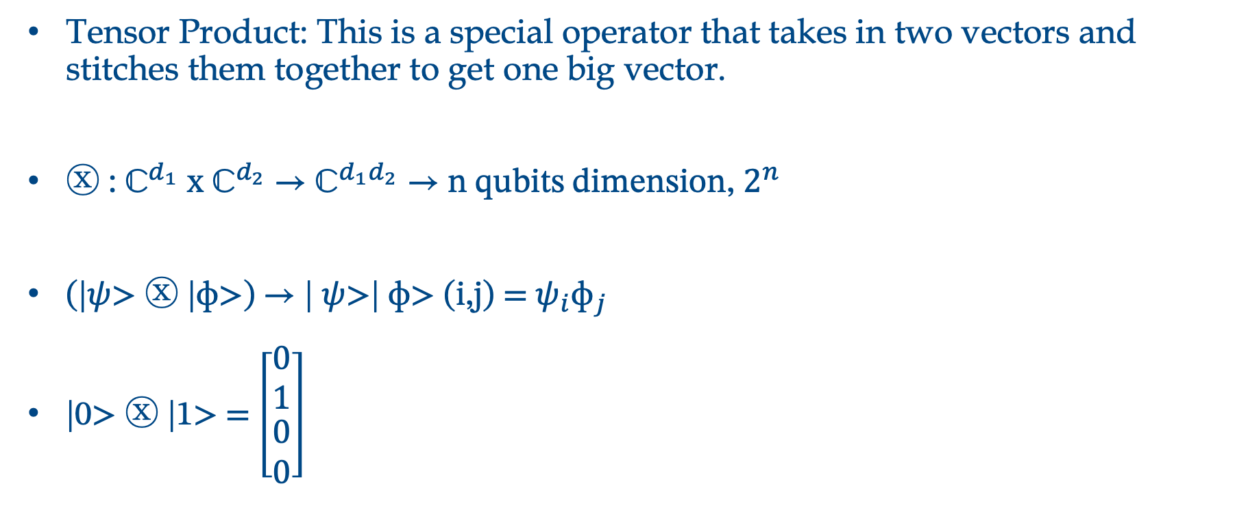
Quantum System
Tensor Product: This is a special operator that takes in two vectors and stitches them together to get one big vector.
ⓧ : ${\text{ℂ}}^{d_{1}}$ x ${\text{ℂ}}^{d_{2}}$ → ${\text{ℂ}}^{d_{1}d_{2}}$ → n qubits dimension, $2^{n}$
(|$ψ$> ⓧ |ɸ>) → | $ψ$>| ɸ> (i,j) = $ψ_{i}{\text{ɸ}}_{j}$
|0> ⓧ |1> = $\left[\begin{matrix}0 \\ 1 \\ \begin{matrix}0 \\ 0\end{matrix}\end{matrix}\right]$

Slide 9
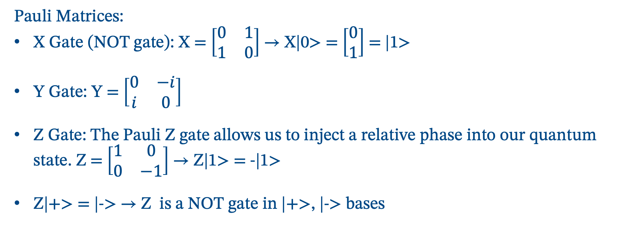
Quantum Operations
Quantum Gates
Pauli Matrices:
X Gate (NOT gate): X = $\left[\begin{matrix}0 & 1 \\ 1 & 0\end{matrix}\right]$ → X|0> = $\left[\begin{matrix}0 \\ 1\end{matrix}\right]$ = |1>
Y Gate: Y = $\left[\begin{matrix}0 & −i \\ i & 0\end{matrix}\right]$
Z Gate: The Pauli Z gate allows us to inject a relative phase into our quantum state. Z = $\left[\begin{matrix}1 & 0 \\ 0 & −1\end{matrix}\right]$ → Z|1> = -|1>
Z|+> = |-> → Z is a NOT gate in |+>, |-> bases

Slide 10
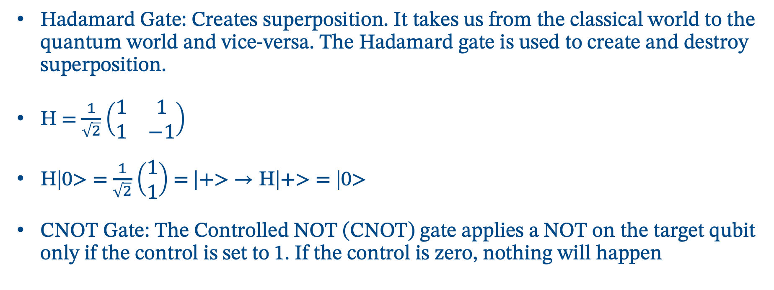
Quantum Operations
Quantum Gates
Hadamard Gate: Creates superposition. It takes us from the classical world to the quantum world and vice-versa. The Hadamard gate is used to create and destroy superposition.
H = $\frac{1}{\sqrt{2}}$ $\left(\begin{matrix}1 & 1 \\ 1 & −1\end{matrix}\right)$
H|0> = $\frac{1}{\sqrt{2}}$ $\left(\begin{matrix}1 \\ 1\end{matrix}\right)$ = |+> → H|+> = |0>
CNOT Gate: The Controlled NOT (CNOT) gate applies a NOT on the target qubit only if the control is set to 1. If the control is zero, nothing will happen

Slide 11
Why Quantum Computer?

Slide 12
The Crisis
The Quantum Advantage
2030: Quantum computers will break RSA encryption
Today: Hackers are stealing encrypted data to decrypt later
Impact: $10.5 trillion annual cybercrime cost by 2025
Shor's Algorithm (1994):
Factor large numbers exponentially faster
Classical: 300,000 years
Quantum: 8 hours
Classical Limits
Real Application Today
Moore’s Law is ending
Exponential problems remain unsolvable
Current encryption will be obsolete
Drug discovery (COVID vaccines)
Financial modeling (Goldman Sachs)
Cybersecurity (IBM, Google)
AI/ML enhancement (quantum neural networks)
Notes:
Here's what keeps cybersecurity professionals awake at night: quantum computers will break RSA encryption by 2030. That's not science fiction - IBM, Google, and others already have working quantum computers.
But here's the really scary part - hackers are already stealing encrypted data TODAY, storing it, waiting for quantum computers to decrypt it later. It's called 'harvest now, decrypt later' and it's happening right now.
Look at these numbers: classical computer needs 300,000 years to break certain encryptions. A quantum computer? 8 hours. That's not an improvement - that's a complete paradigm shift.
[Point to applications]
The good news? The same technology threatening our security can also protect us. Companies are already using quantum computing for drug discovery - COVID vaccines were partially developed using quantum simulations. Goldman Sachs uses it for financial modeling.
This isn't future tech - it's here now, and you need to understand it."

Slide 13
Quick Setup
# Install Qiskit
pip install qiskit qiskit-aer matplotlib
# Create IBM Quantum account
# Visit: quantum-computing.ibm.com
# Get your API token
# 3. Connect to real quantum computer
from qiskit_ibm_runtime import QiskitRuntimeService
from qiskit import QuantumCircuit
import warnings
warnings.filterwarnings('ignore')
print("✅ Libraries imported successfully!")
print("📝 Next: Replace 'YOUR_API_TOKEN' below with your actual token")
# SSave your credentials (REPLACE 'YOUR_API_TOKEN' with your actual token!)
# ⚠️ IMPORTANT: Only run this ONCE per computer/environment
# REPLACE THIS with your actual token from quantum.ibm.com
YOUR_API_TOKEN = "YOUR_API_TOKEN_HERE" # ← Put your token between the quotes
try:
# Save account credentials (one-time setup)
service = QiskitRuntimeService.save_account(
channel="ibm_quantum_platform",
token=YOUR_API_TOKEN,
overwrite=True
)
print("✅ Account saved successfully!")
print("🎉 You can now access IBM Quantum computers!")
except Exception as e:
if "YOUR_API_TOKEN" in YOUR_API_TOKEN:
print("❌ ERROR: You need to replace 'YOUR_API_TOKEN_HERE' with your actual token!")
print("🔗 Get your token from: https://quantum.ibm.com")
else:
print(f"❌ Error saving account: {e}")
print("💡 Make sure your token is correct and try again")

Slide 14
Build a Gate
# Gate playground
qc = QuantumCircuit(3, 3)
# Try different gates
qc.h(0) # Superposition
qc.x(1) # NOT gate
qc.y(2) # Y rotation
qc.cx(0, 1) # CNOT
qc.cz(1, 2) # Controlled-Z
# Add measurements
qc.measure_all()
# Draw the circuit
print(qc.draw())

Slide 15
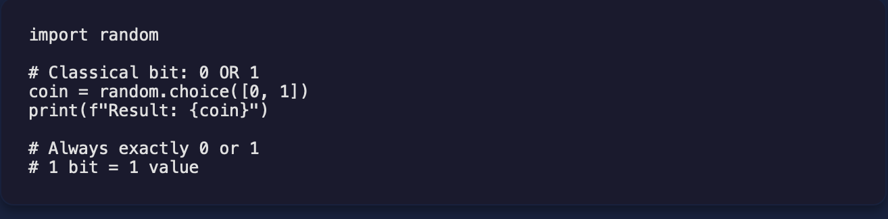
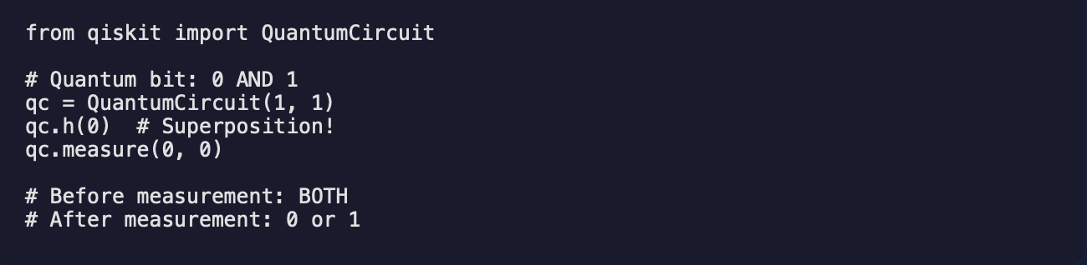
The Quantum Difference
Interactive Demo: Coin Flip Comparison
Classical coin Quantum Coin
Notes:
from qiskit import QuantumCircuit
from qiskit_aer import AerSimulator
# Quantum bit: 0 AND 1
qc = QuantumCircuit(1, 1)
qc.h(0) # Superposition!
qc.measure(0, 0)
# Before measurement: BOTH
# After measurement: 0 or 1
# Let's see the circuit
print("Circuit:")
print(qc.draw())
# Now let's simulate it multiple times
simulator = AerSimulator()
job = simulator.run(qc, shots=1000)
result = job.result()
counts = result.get_counts()
print(f"\nResults after 1000 shots:")
print(f"0: {counts.get('0', 0)} times")
print(f"1: {counts.get('1', 0)} times")
print(f"\nProbabilities:")
print(f"0: {counts.get('0', 0)/1000:.1%}")
print(f"1: {counts.get('1', 0)/1000:.1%}")
# Run a single shot to see one result
single_job = simulator.run(qc, shots=1)
single_result = single_job.result()
single_counts = single_result.get_counts()
measurement = list(single_counts.keys())[0]
print(f"\nSingle measurement result: {measurement}")
In classical computing, a bit is either 0 or 1. Just like a coin is either heads or tails. Simple, binary, one or the other.
[Click quantum button]
But a quantum bit - a qubit - can be BOTH 0 and 1 simultaneously. This is called superposition. It's not that we don't know which one it is - it literally IS both until we measure it.
Here's the mind-blowing part: while a classical computer with 300 bits can store one number at a time, a quantum computer with 300 qubits can process MORE numbers simultaneously than there are atoms in the universe.
[Run the code comparison]
Look at this code - classical on the left, quantum on the right. The classical code gives us one value. The quantum code? It explores all possibilities at once.
This isn't just a neat trick - this is why quantum computers can break encryption. They can try all possible keys simultaneously instead of one at a time."
Transition: "Let's actually create superposition ourselves. Open your Python environment..."

Slide 16
Superposition
Live Coding: Create Your First Superposition
# Step 1: Install packages (if needed)
# pip install qiskit qiskit-aer matplotlib
# Step 2: Import libraries
from qiskit import QuantumCircuit
from qiskit_aer import AerSimulator
from qiskit.visualization import plot_histogram
import matplotlib.pyplot as plt
# Configure matplotlib for inline plotting in notebooks
%matplotlib inline
# Step 3: Create a quantum circuit
qc = QuantumCircuit(1, 1) # 1 qubit, 1 classical bit
# Step 4: Apply Hadamard gate for superposition
qc.h(0) # Put qubit 0 in superposition
# Step 5: Measure the qubit
qc.measure(0, 0)
print("Circuit diagram:")
print(qc.draw())
# Step 6: Run the circuit 1000 times
simulator = AerSimulator()
job = simulator.run(qc, shots=1000)
result = job.result()
counts = result.get_counts()
print(f"\nResults: {counts}")
print("\nCreating histogram...")
# Visualize the results
fig = plot_histogram(counts, title='Quantum Superposition Results (1000 shots)')
plt.tight_layout()
plt.show()

Slide 17
Entanglement
Build a Bell State
# Create entangled qubits (Bell State) - Modern Qiskit syntax
from qiskit import QuantumCircuit
from qiskit_aer import AerSimulator
from qiskit.visualization import plot_histogram
import matplotlib.pyplot as plt
# Create circuit with 2 qubits
qc = QuantumCircuit(2, 2)
# Step 1: Create superposition on qubit 0
qc.h(0)
# Step 2: Entangle qubit 0 with qubit 1
qc.cx(0, 1) # CNOT gate creates entanglement!
# Step 3: Measure both qubits
qc.measure([0, 1], [0, 1])
# Visualize the circuit
print("🔗 Bell State Circuit (Entangled Qubits):")
print(qc.draw())
# Run the entangled circuit
simulator = AerSimulator()
job = simulator.run(qc, shots=1000)
result = job.result()
counts = result.get_counts()
print(f"\n📊 Bell State Results (1000 shots):")
for outcome, count in counts.items():
print(f" |{outcome}⟩: {count} times ({count/1000:.1%})")
print("\n🎯 What makes this special?")
print(" - You get ONLY |00⟩ and |11⟩ outcomes")
print(" - You NEVER get |01⟩ or |10⟩!")
print(" - The qubits are perfectly correlated (entangled)")
print(" - If one is 0, the other is always 0")
print(" - If one is 1, the other is always 1")
# Show histogram
plot_histogram(counts, title='Bell State: Entangled Qubits Results')
plt.tight_layout()
plt.show()

Slide 18
Challenges
Noisy Qubits: Errors affecting accuracy and reliability.
Limited Scalability: Struggles with large datasets and complex problems.
Coherence Time: Maintaining quantum properties for longer durations.
Designing QML Algorithms: Adapting classical algorithms effectively.
Hybrid Quantum-Classical Computing: Integrating both technologies effectively.
Notes:
No conventional hardware can generate truly random number, that;s why the generators in conventional computers are referred to as “spontatneous pseudo generators”. This is however, a straight forward task for a quantum computer

Slide 19
https://learning.quantum.ibm.com/course/fundamentals-of-quantum-algorithms https://www.ibm.com/quantum/qiskit https://quantum.ibm.com https://learning.edx.org/course/course-v1:PurdueX+ECE_69501.3+1T2024/home https://qiskit-community.github.io/qiskit-machine-learning/tutorials/02a_training_a_quantum_model_on_a_real_dataset.html# https://github.com/Qiskit/textbook/blob/main/notebooks/quantum-machine-learning/supervised.ipynb
Reference

Slide 20

This Photo by Unknown Author is licensed under CC BY-SA-NC

Slide 21

Questions
This Photo by Unknown Author is licensed under CC BY-NC

